Slide 1
Privacy Friendly 2048
Lidia Berhe
&
Maudeline Deus

Slide 2
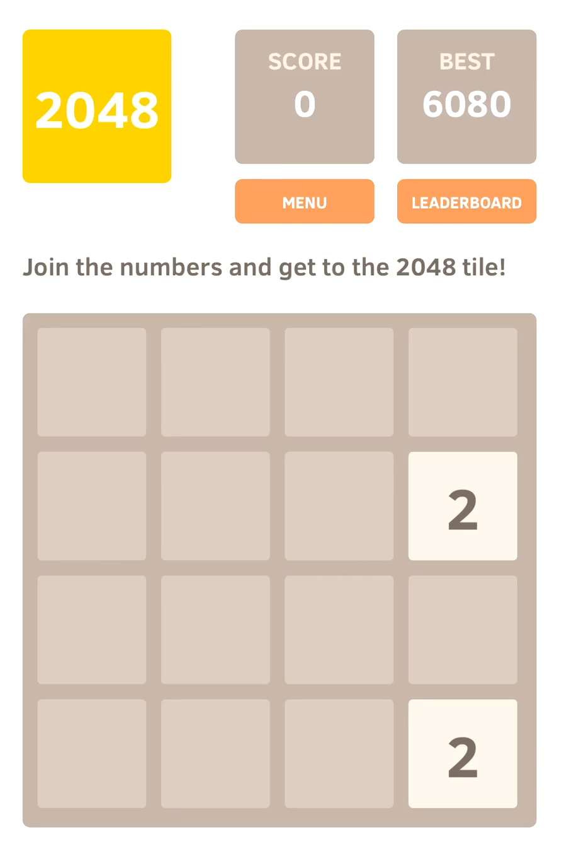
What is 2048?
Notes:
lidia

Slide 3
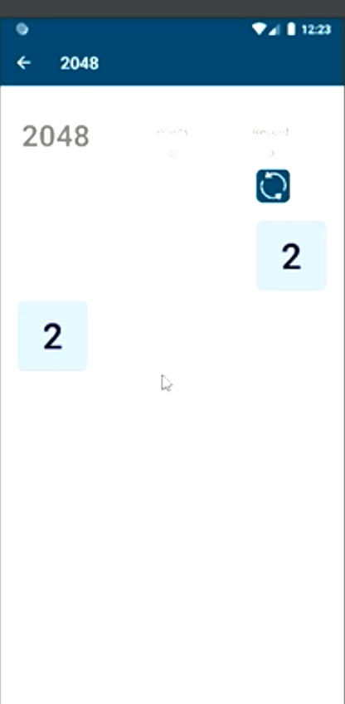
So... What is privacy friendly 2048?
Notes:
lidia

Slide 4


PfA2048 Implementation
Notes:
maudeline

Slide 5
Testing Techniques
Blackbox Testing
Integration Testing
Whitebox Testing
GUI Testing
Notes:
maudeline

Slide 6

Code base Limitations
bad programming practices ☹
Notes:
lidia

Slide 7

GUI Tests
Espresso Testing Framework
Currently, tests on...
TutorialActivity & SplashActivity
MainActivity
GameActivity
Remaining tasks...
AboutActivity
HelpActivity
StatsActivity
Elements
Adding more tests to GameActivity
Notes:
lidia

Slide 8
GUI Test Demo
Notes:
lidia

Slide 9
GUI TEST RESULTS
So far...

Slide 10

GUI TEST RESULTS
So far...
No failures!

Slide 11
Metrics (GUI)
Tested Activity | Sratement Coverage | Branch Coverage
AboutActivity | 100% | 50%
HelpActivity | 100%
MainActivity | 98% | 81%
TutorialActivity | 96% | 70%
MainActivity | 84% | 50%
GameActivity | 71% | 61%
TOTAL (in activities) | 69% | 56%
Notes:
lidia

Slide 12
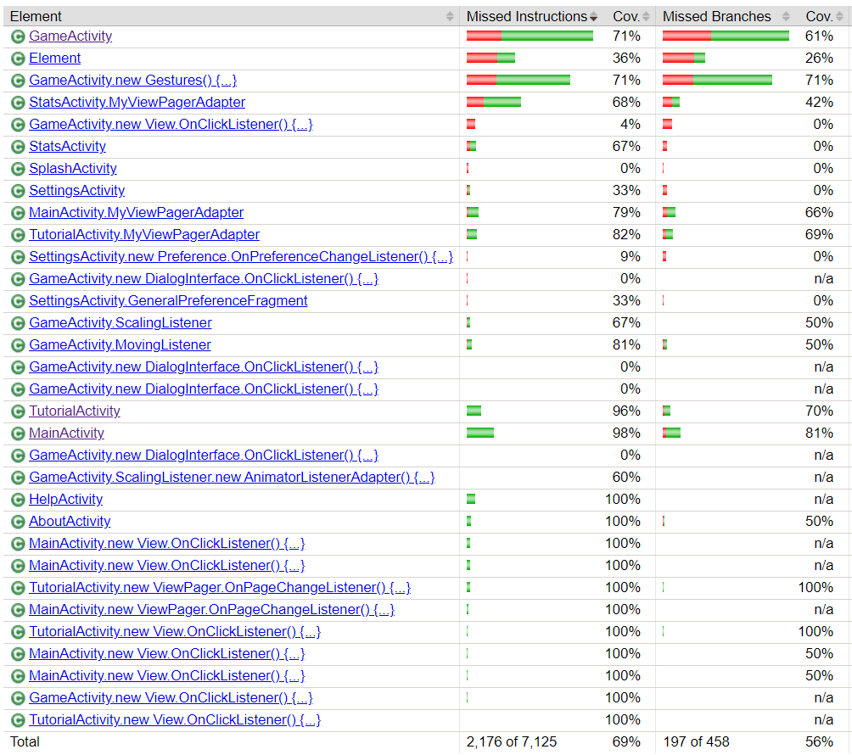
Metrics (GUI)
Notes:
lidia

Slide 13
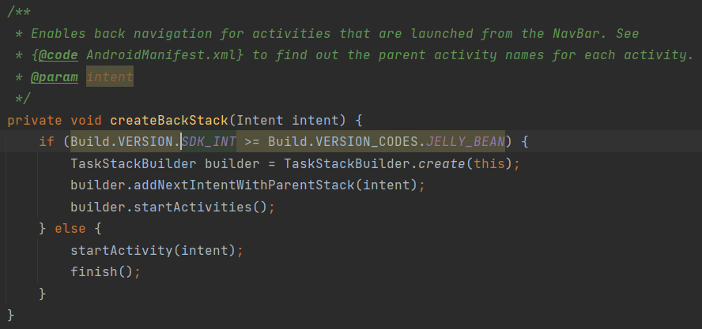
:(

Slide 14

Unit Tests
BLACKBOX INPUT SPACE
Object Input: null, object
File Input: empty, nonexistent, corrupted, correct state, incorrect state, null
Java Primitive Input: boundary values
INTEGRATION TESTING
Calling I/O function to write to file and another to read from that file
Incorporated with different input spaces
WHITEBOX TESTING
To cover the branches
Notes:
maudeline

Slide 15
Unit Test Demo
Notes:
maudeline

Slide 16
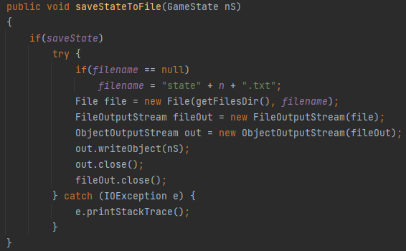
Unit TEST Failures
Does not check for null object when saving GameState object
Notes:
maudeline

Slide 17
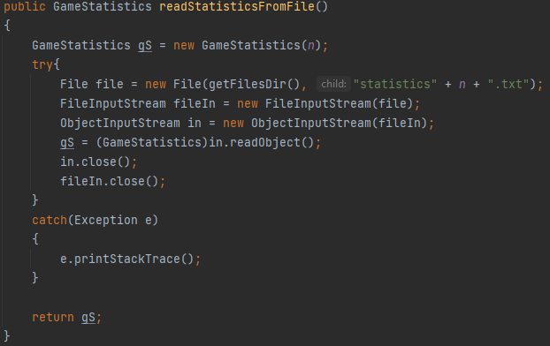
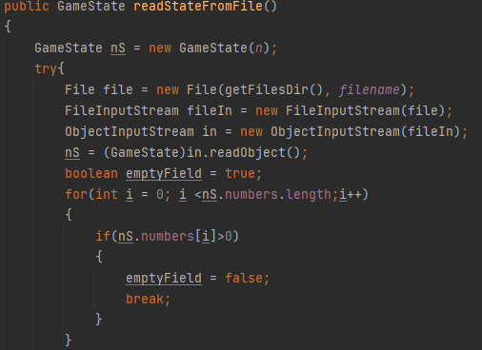
Unit test failures
Does not check if the object read from the file is not null and returns null object ending in a NullPointerException

Slide 18
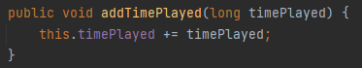
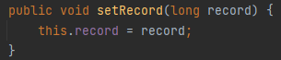
Unit test failures
Time Played
Game record
Can set negative time played
Does not check for overflow
Can set negative record

Slide 19
Metrics (Unit Tests)
Objects & Activities | Line Coverage
Element | 95%
StatsActivity | 72%
MainActivity | 59%
GameStatistics | 70%
GameState | 39%
GameActivity | 18%
Notes:
lidia

Slide 20
Unit test Results
Overall good handling for exceptions thrown
Returns new Object when exception is thrown
Failed to handle reading in a null object from file
Bad as these files are necessary for the game
Not good stand-alone functions

Slide 21



FUTURE pLANS
GUI tests
Unit tests
Goal
Several activities and user navigations to be tested
AboutActivity
HelpActivity
StatisticsActivity
Adding more tests to GameActivity
Many functions to be tested and branches to be covered
Achieve 100% branch coverage
Notes:
maudeline

Slide 22



Project Takeaways
Application
Adaptation
Code base…
Applying techniques from class to a real-world example
Applying fundamentals from one testing framework to another
Not all published apps are implemented with good programming techniques

Slide 23
THANK YOU! :)
Questions?

